Slide 1
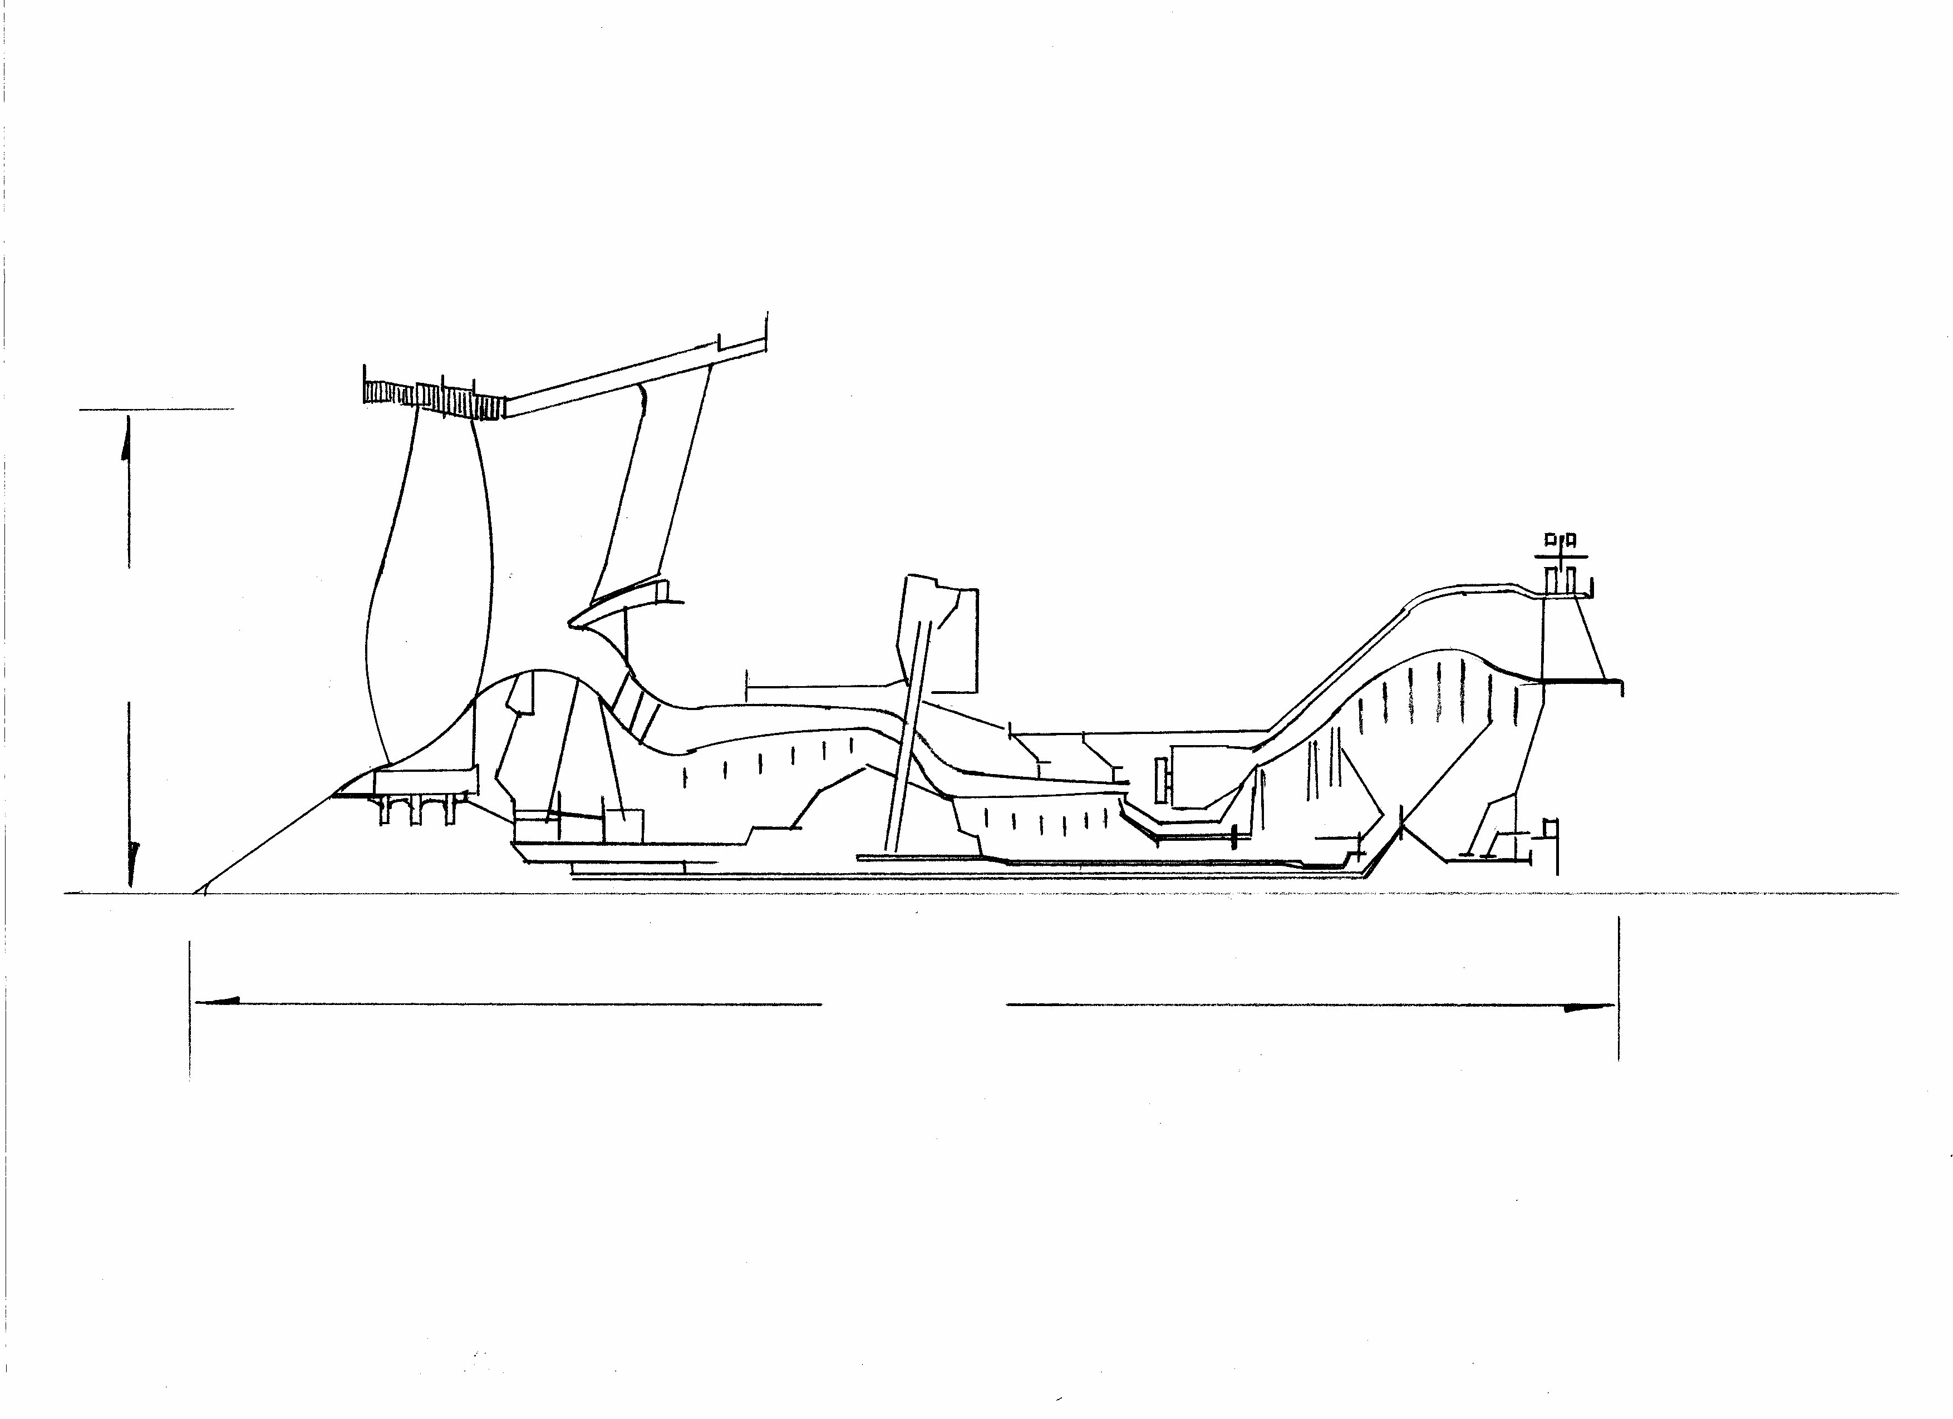
Turbofan Engine Section
(66 kN ISA + 15K takeoff thrust engine)
Includes indicative location of rotating stages
627 mm
Fan radius
2369 mm bare
engine length
1210 mm
Cof G Location

Slide 2
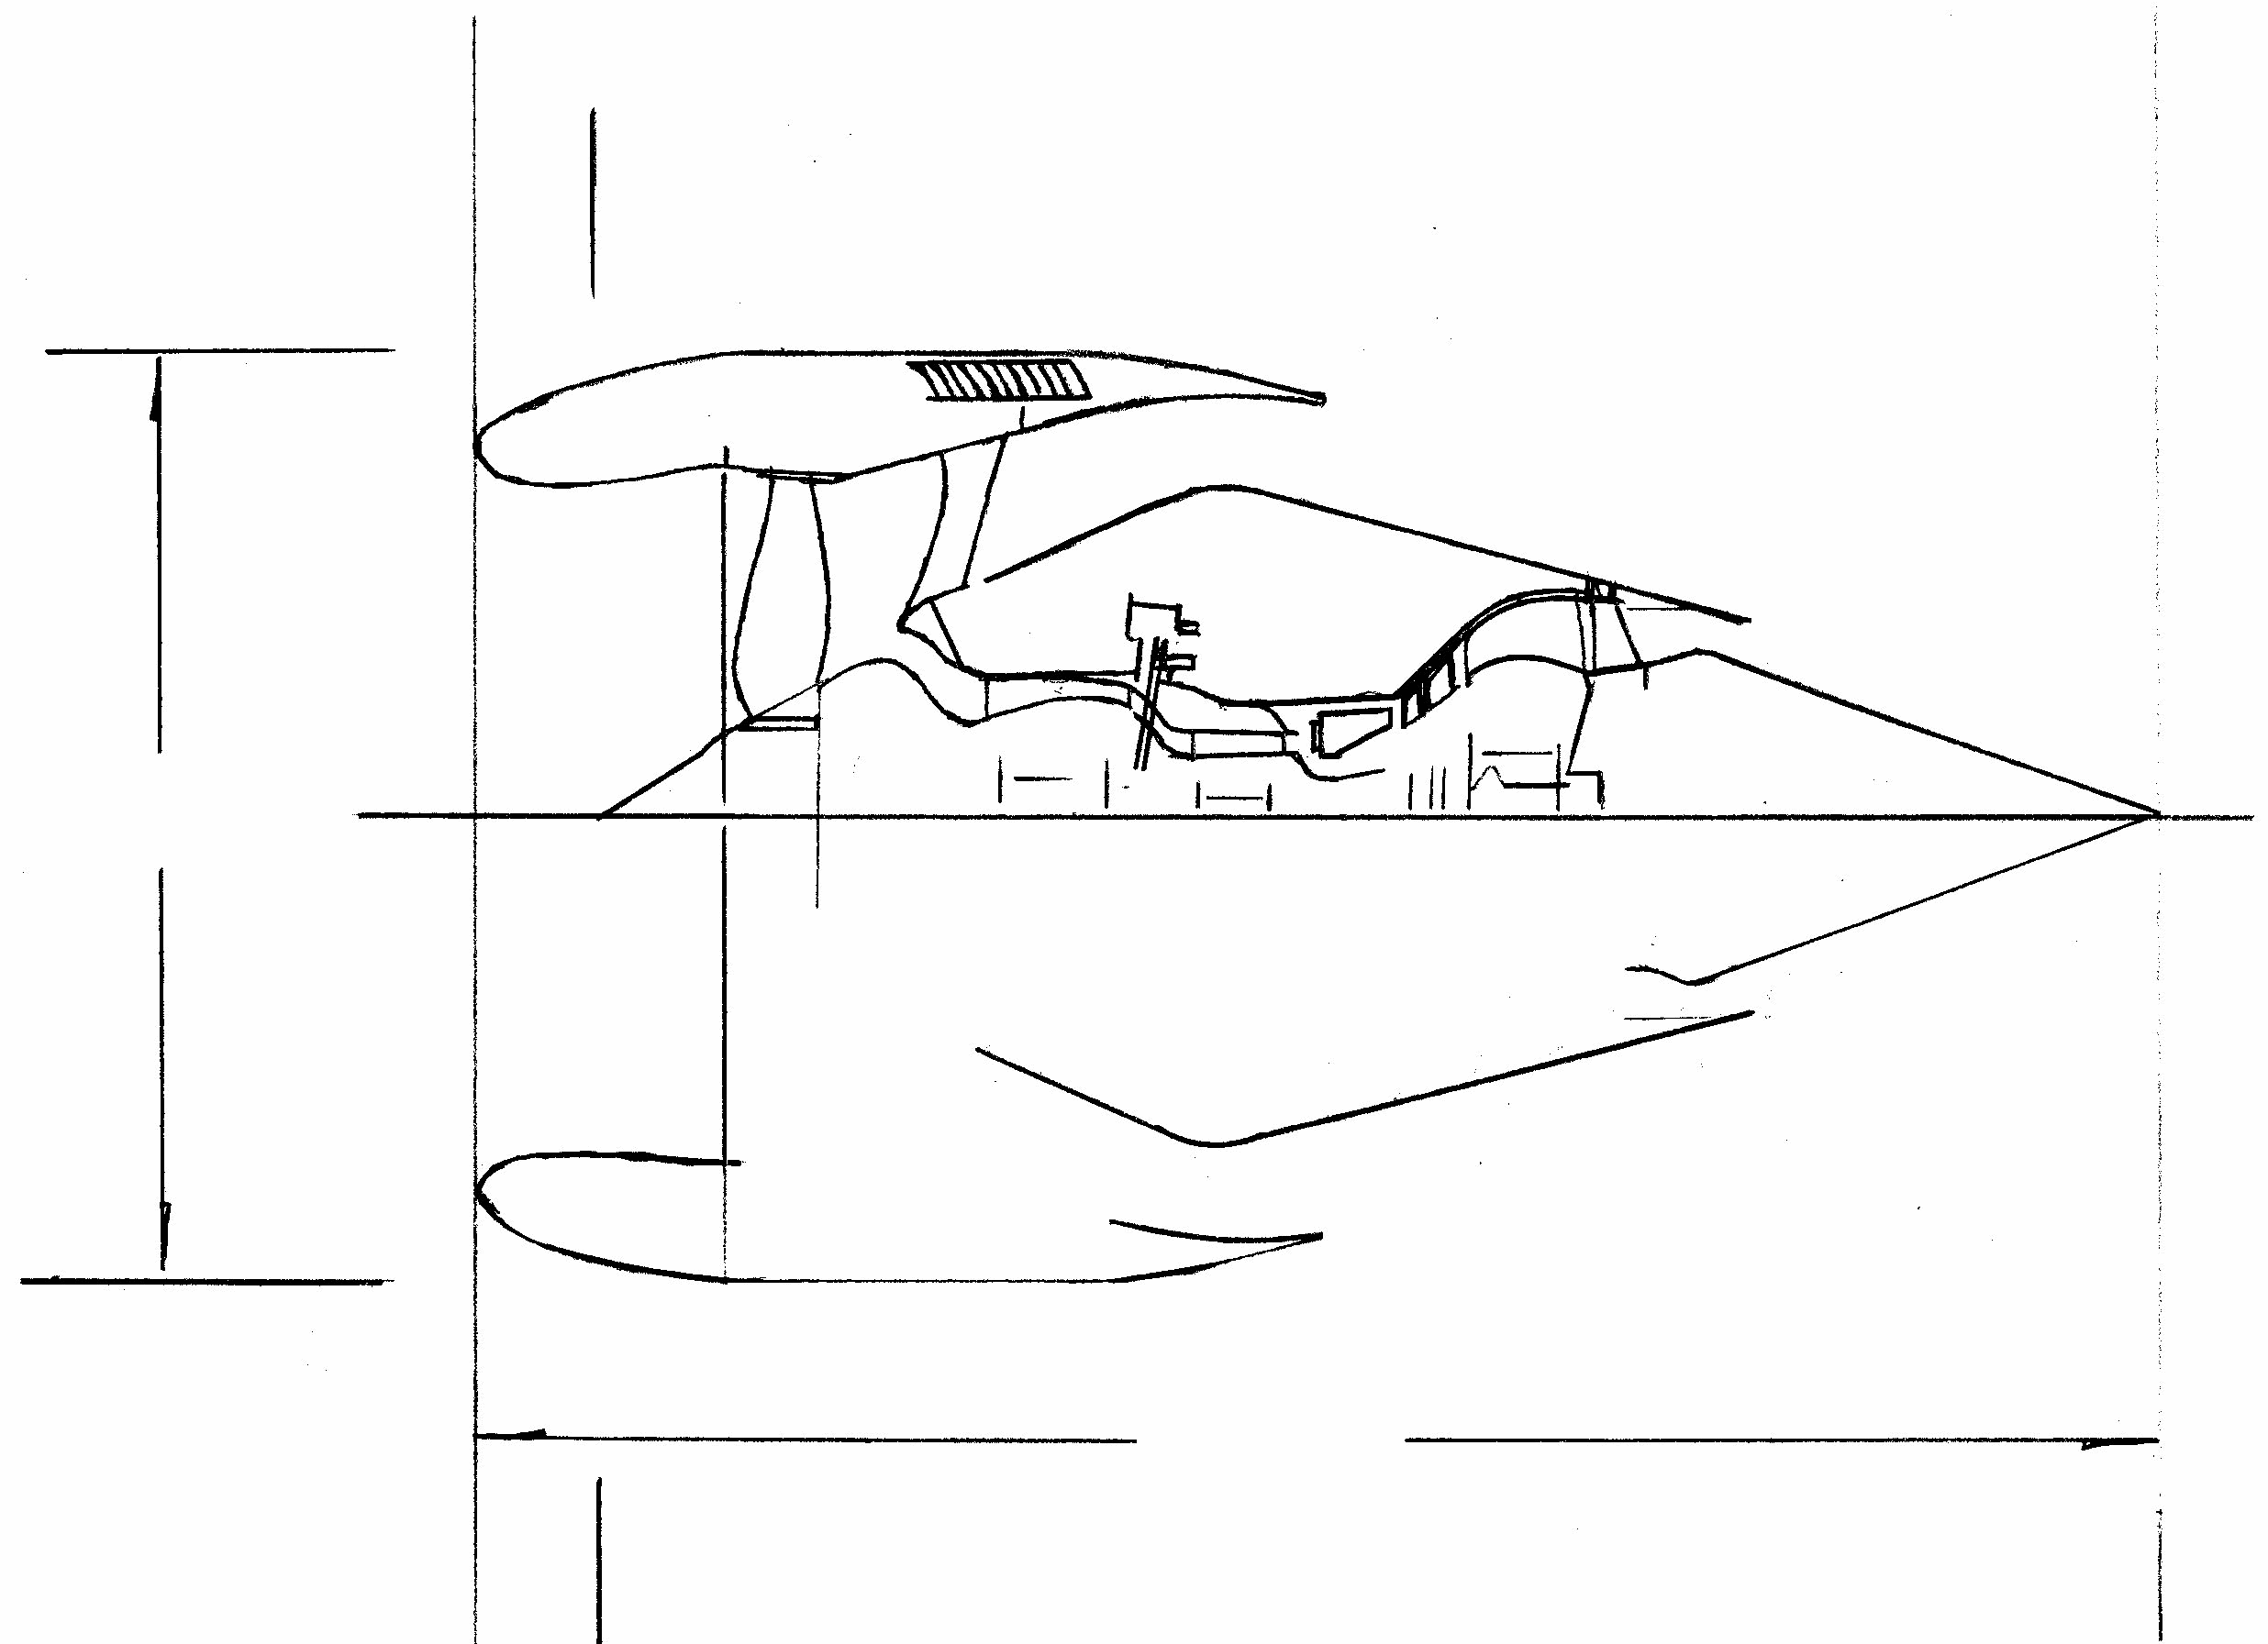
Podded Turbofan Engine Section
(66 kN ISA + 15K takeoff thrust engine)
1732 mm pod
max diameter
3889 mm
powerplant
length

Slide 3
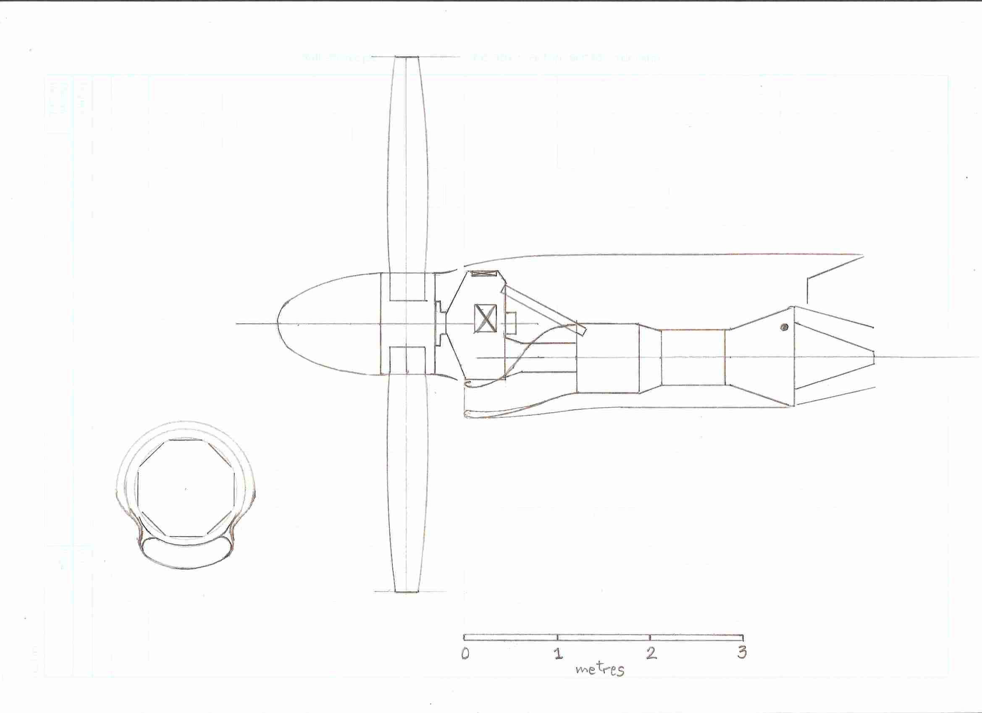
4745 kW (59 kN sea-level ISA + 15K take-off) Turboprop Engine
4547 mm

